Slide 1
ENGR 216 – Spring 2019
Class 05
Descriptive Statistics - II

Slide 2
Learning Objectives
Use z-table calculations to compute a confidence interval on the mean with a specified degree of confidence given the population standard deviation and test data.

Slide 3
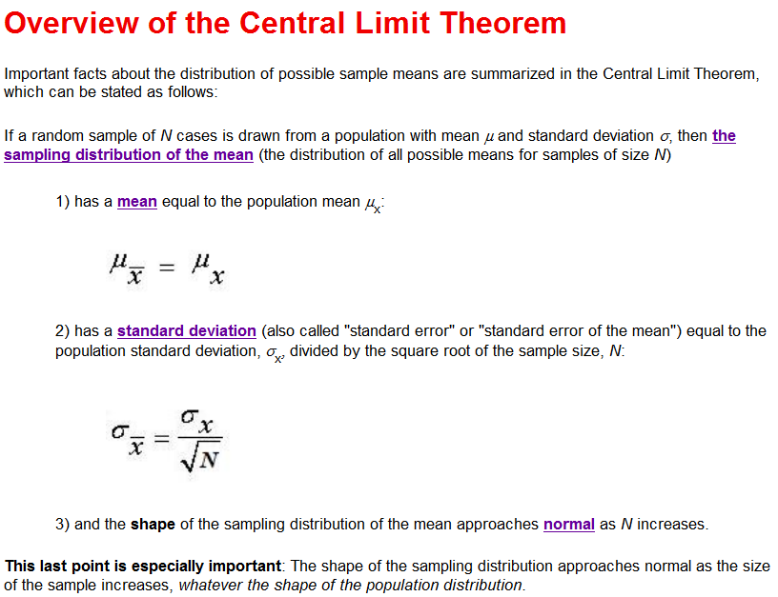
Central Limit Theorem (CLT) Source: http://wise1.cgu.edu/cltmod/reviewclt.asp (this link will take to you a nice tutorial)
Describes distribution of possible sample means
Random sample of N cases from a population with mean, µ, and standard deviation, δ:
Sampling distribution of the mean (distribution of all possible means for samples of size N):
1) has a mean equal to the population mean µ_{x}:
2) has a standard deviation (aka standard error or standard error of the mean) equal to the population standard deviation, δ_{x}, divided by the square root of the sample size, N:
3) the shape of the sampling distribution of the mean approaches normal as N increases, regardless of the shape of the population distribution.

Slide 4
Overview of the CLT continued
The CLT allows us to determine the likely accuracy of a sample mean, but only if the sampling distribution of the mean is approximately normal.
If population distribution is normal: sampling distribution of the mean will be normal for any sample size, N (even N = 1).
If population distribution is not normal, has a bump in the middle, no extreme scores, and no strong skew: sampling distribution of the mean will be very close to normal for a sample of modest size (e.g., N = 30)
If the population distribution is far from normal (e.g., extreme outliers or strong skew): to produce a sampling distribution of the mean that is close to normal a very large sample may be needed(e.g., N = 500 or more).
Important note: You should not assume that the sampling distribution of the mean is normal without considering the shape of the population distribution and the size of your sample. A sample with N > 30 does not guarantee a normal sampling distribution if the population distribution is far from normal.

Slide 5
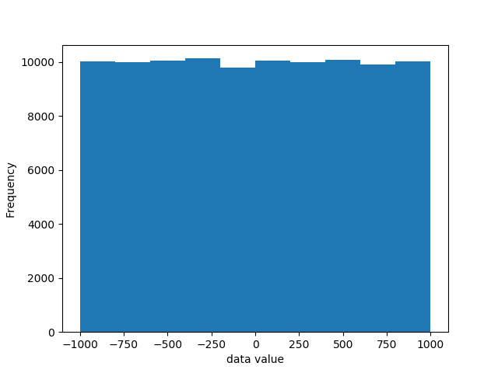
Example
On eCampus there is a file ClassData.csv. Code to load it and plot a histogram of the data is given below (try it yourself):
import csv import matplotlib.pyplot as plt import numpy as np with open('c:\work\Class5Data.csv') as csv_file: csv_reader = csv.reader(csv_file, delimiter = ',') data = [] for row in csv_reader: data.append(float(row[0])) # now make a histogram npData = np.asarray(data) histCount, bin_edges = np.histogram(npData) print(histCount) n, bins, patches = plt.hist(x=npData) plt.xlabel('data value') plt.ylabel('Frequency') plt.show()

Slide 6
Illustration of CTL
Now let’s write Python code that will:
Creates an array of 10 random values from the data set
Computes the average of this sample, and appends this mean to a list
Repeats this 200 times
After we have 200 sample means, create a histogram of the sample means

Slide 7
Some more code for you to try (one script in two columns)
import csv import matplotlib.pyplot as plt import numpy as np from random import randint from statistics import mean with open('c:\work\Class5Data.csv') as csv_file: csv_reader = csv.reader(csv_file, delimiter = ',') data = [] for row in csv_reader: data.append(float(row[0])) # we will need the size of the data list later m = len(data) # now select k random values from the data and calculate their mean # repeat this 200 times k = 10 means = []
for i in range(200): x = [] for j in range(k): n = randint(0,m-1) x.append(data[n]) means.append(mean(x))
n, bins, patches = plt.hist(x=means, bins = 20) plt.xlabel('sample mean value') plt.ylabel('Frequency') titleString = 'k = '+ str(k) plt.title(titleString) plt.show()

Slide 8
Two new functions
from random import randint
Gives us a random integer between the two values in its parentheses
from statistics import mean
Gives us the average of the values in its parentheses
Note that the results will be slightly different every time you run this program, because the random values will be different
Let’s run our program with different values of k and see what impact the sample size has on the sample distribution of the mean

Slide 9
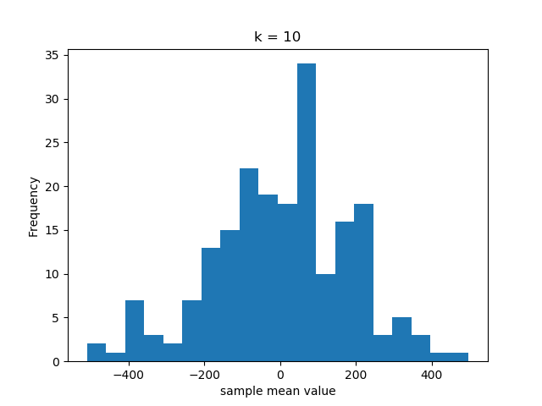
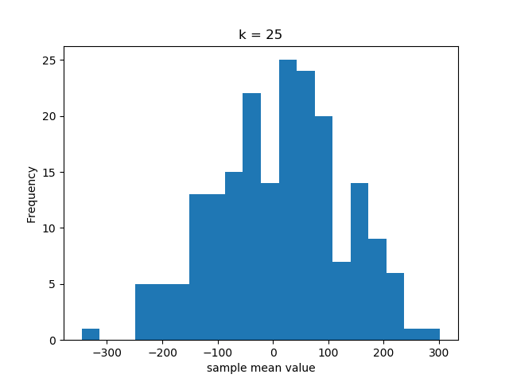
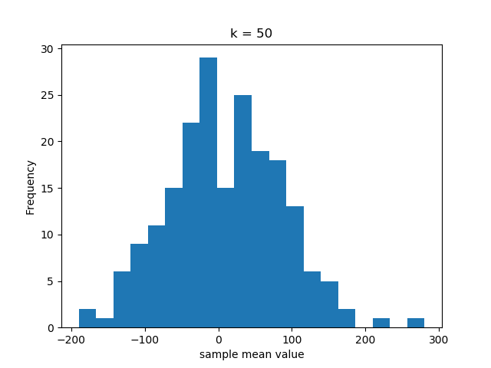
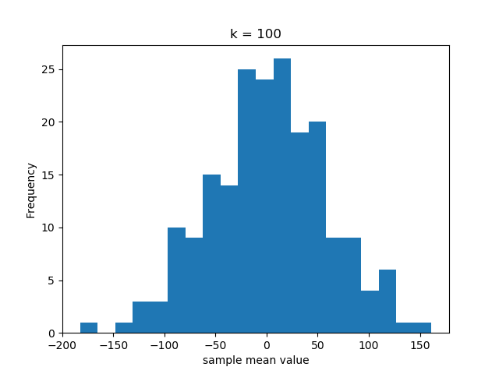
Typical results

Slide 10
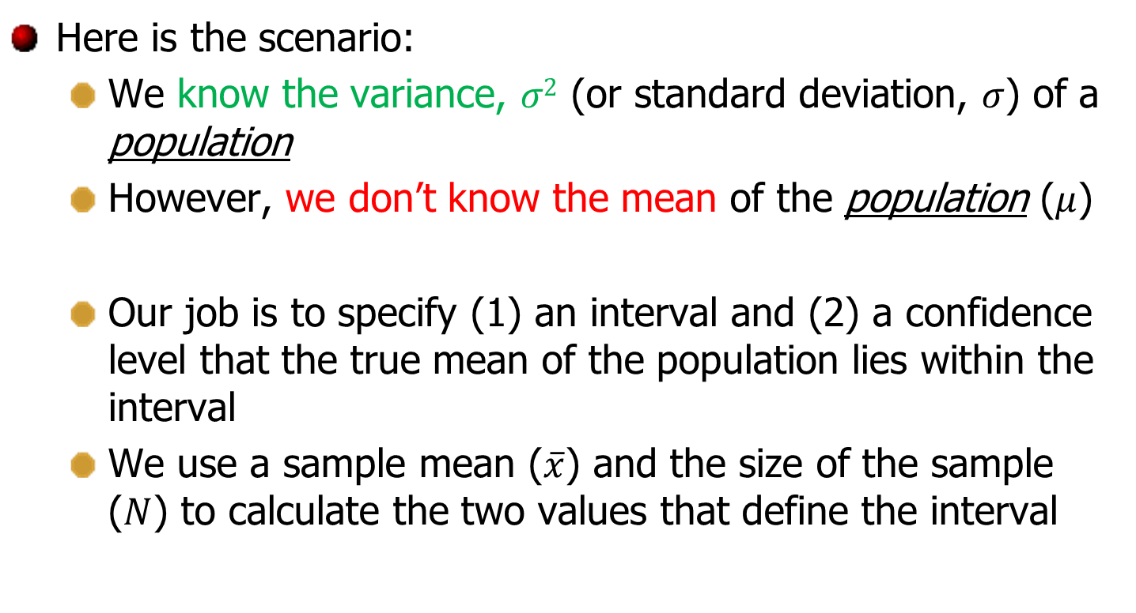
Confidence Interval (CI)
Here is the scenario:
We know the variance, $σ2$ (or standard deviation, $σ$) of a population
However, we don’t know the mean of the population ($μ$)
Our job is to specify (1) an interval and (2) a confidence level that the true mean of the population lies within the interval
We use a sample mean ($\overline{x}$) and the size of the sample ($N$) to calculate the two values that define the interval

Slide 11
Confidence Interval (CI)
The Need: Point estimate does not provide enough information about a parameter
Usually, we prefer to have an interval in which we would expect to find the true mean. This interval is called Confidence Interval (CI).
L is the lower confidence limit and U is the upper confidence limit
We would say, for example, that we are 95% confident that the true mean lies between L and U

Slide 12


Alpha ($α$)
Suppose we want to construct an interval so that the probability that z_{L} < z < z_{U} is 0.95 or 95%
How much area is in the red region?
How much area is in the tails?
z_{L}
z_{U}
0
In this case, $α=0.05$

Slide 13

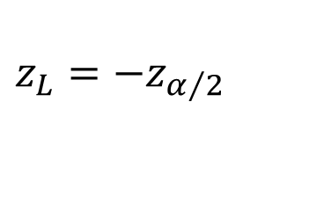
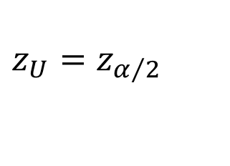


Using alpha ($α$)
We want to construct the confidence interval centered on the mean so that the probability that z_{L} < z < z_{U} is p %
The area in white under the standard normal curve is $α.$
$$\frac{p}{100}=1−α$$
So
$$p=100(1−α)$$
or equivalently
$$α=1−\frac{p}{100}$$
$$z_{L}=−z_{α/2}$$
$$z_{U}=z_{α/2}$$
0

Slide 14
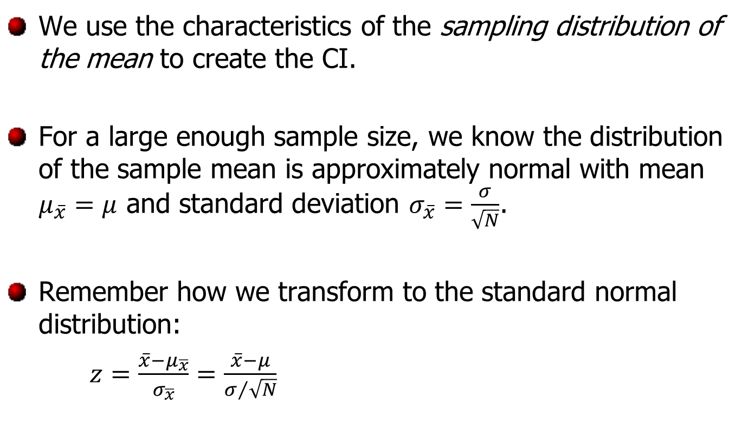
Back to Confidence Intervals
We use the characteristics of the sampling distribution of the mean to create the CI.
For a large enough sample size, we know the distribution of the sample mean is approximately normal with mean $μ_{\overline{x}}=μ$ and standard deviation $σ_{\overline{x}}=\frac{σ}{\sqrt{N}}$.
Remember how we transform to the standard normal distribution:
$z=\frac{\overline{x}−μ_{\overline{x}}}{σ_{\overline{x}}}=\frac{\overline{x}−μ}{σ/{\sqrt{N}}}$

Slide 15
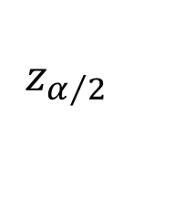
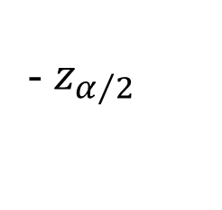
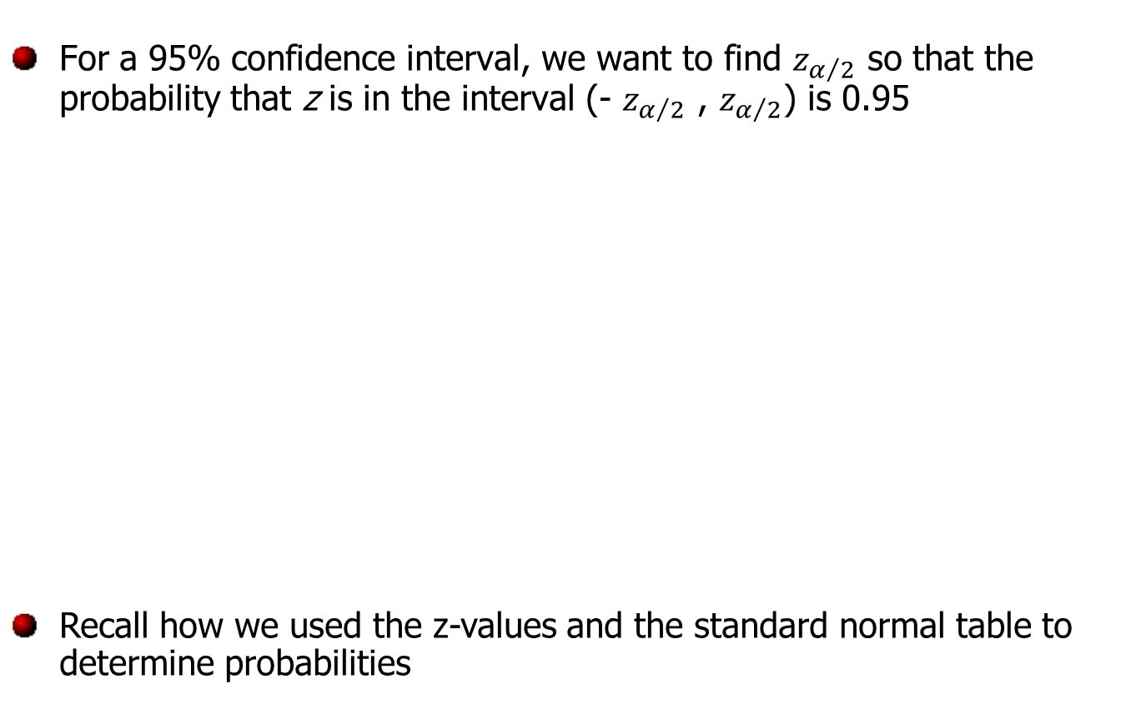
Find the z-value
For a 95% confidence interval, we want to find $z_{α/2}$ so that the probability that z is in the interval (- $z_{α/2}$ , $z_{α/2}$) is 0.95
Recall how we used the z-values and the standard normal table to determine probabilities
- $z_{α/2}$
$z_{α/2}$
0

Slide 16
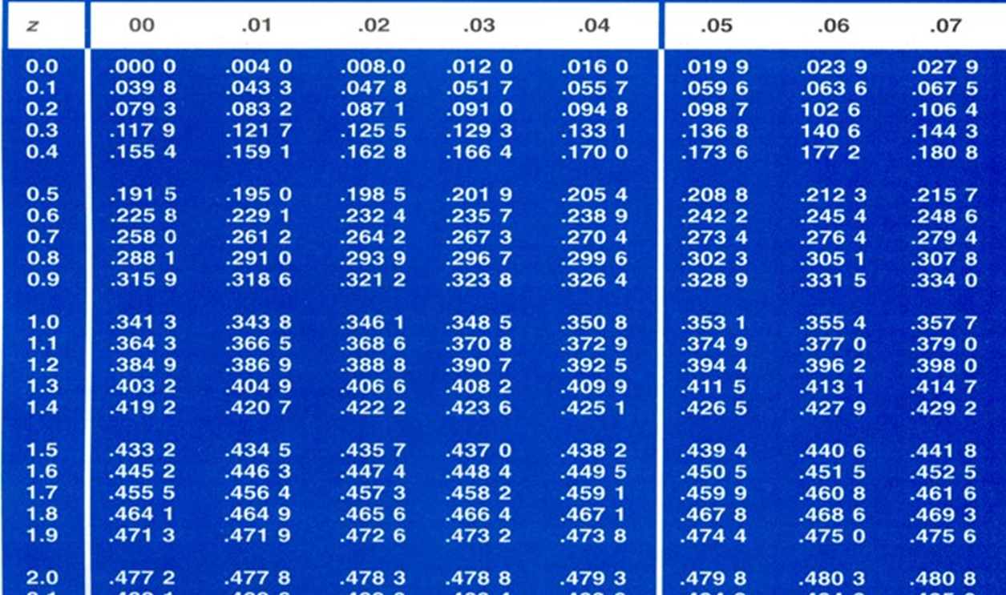
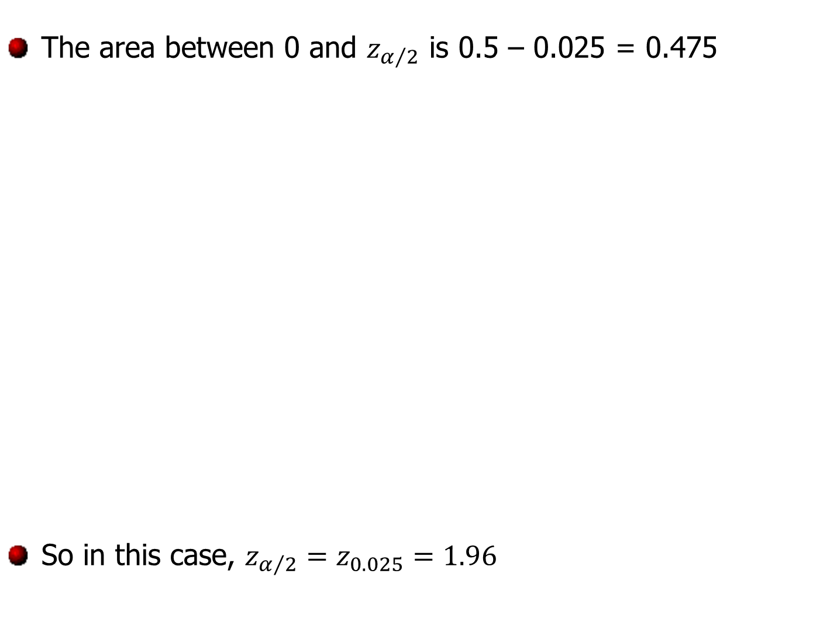
Find the z-value
The area between 0 and $z_{α/2}$ is 0.5 – 0.025 = 0.475
So in this case, $z_{α/2}=z_{0.025}=1.96$

Slide 17
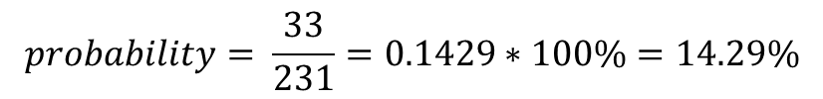
Putting it all together
We have constructed an interval so that
$$P\left(−z_{α/2}<z<z_{α/2}\right)=1−α$$
Using the transformation of the sampling distribution for the mean to the standard normal distribution, we know
$$P\left(−z_{α/2}<\frac{\overline{x}−μ}{σ/{\sqrt{N}}}<z_{α/2}\right)=1−α$$
But we just want an interval containing $μ.$ Some good algebra skills get us
$$P\left(\overline{x}−z_{α/2}\frac{σ}{\sqrt{N}}<μ<\overline{x}+z_{α/2}\frac{σ}{\sqrt{N}}\right)=1−α$$

Slide 18
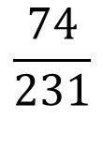
Confidence interval of $μ$ with known $σ$
If $\overline{x}$ is the mean of a random sample of size N from a population with known variance $σ^{2}$, a $100\left(1−α\right)\%$ confidence interval for $μ$ is given by
$$\overline{x}−z_{α/2}\frac{σ}{\sqrt{N}}<μ<\overline{x}+z_{α/2}\frac{σ}{\sqrt{N}}$$
where $z_{α/2}$ is the $z$-value leaving an area of $α/2$ to the right.
Walpole, Ronald E. et al. Probability & Statistics for Engineers & Scientists, 8th ed. Pearson Prentice Hall: Upper Saddle River, NJ, 2007, p. 275.

Slide 19
Confidence Interval Example 1
A soft-drink machine is regulated so that the amount of drink dispensed is approximately normally distributed with standard deviation equal to 0.15 deciliter. Find a 95 % confidence level for the mean of all drinks dispensed by this machine if a random sample of 36 drinks has an average content of 2.25 deciliters.

Slide 20
Confidence Interval Example 1
A soft-drink machine is regulated so that the amount of drink dispensed is approximately normally distributed with standard deviation equal to 0.15 deciliter. Find a 95 % confidence level for the mean of all drinks dispensed by this machine if a random sample of 36 drinks has an average content of 2.25 deciliters.
$$\overline{x}=2.25$$
$$σ=0.15$$
$$N=36$$
$$α=1−0.95=0.05$$
What z-value do we need?

Slide 21
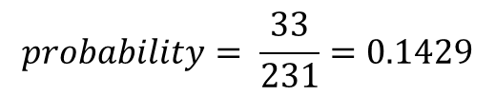
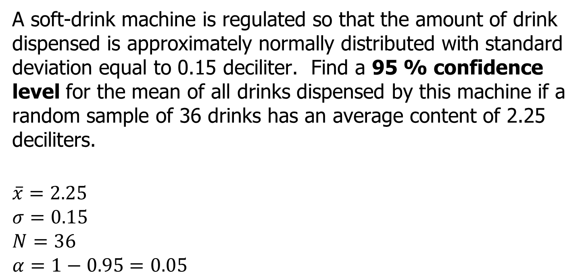
Confidence Interval Example 1
A soft-drink machine is regulated so that the amount of drink dispensed is approximately normally distributed with standard deviation equal to 0.15 deciliter. Find a 95 % confidence level for the mean of all drinks dispensed by this machine if a random sample of 36 drinks has an average content of 2.25 deciliters.
$$\overline{x}=2.25$$
$$σ=0.15$$
$$N=36$$
$$α=1−0.95=0.05$$
$$\overline{x}−z_{α/2}\frac{σ}{\sqrt{N}}<μ<\overline{x}+z_{α/2}\frac{σ}{\sqrt{N}}$$
$$2.25−1.96\frac{0.15}{\sqrt{36}}<μ<2.25+1.96\frac{0.15}{\sqrt{36}}$$
$$2.20<μ<2.30$$

Slide 22
Confidence Interval Example 2
A soft-drink machine is regulated so that the amount of drink dispensed is approximately normally distributed with standard deviation equal to 0.15 deciliter. Find a 90 % confidence level for the mean of all drinks dispensed by this machine if a random sample of 36 drinks has an average content of 2.25 deciliters.
What is different?
How do you handle it?
What difference does it make in the resulting interval?
Notes:
Confidence interval decreased from 95% to 90%
Redo calculations with new z-value from table (1.645)
Makes it smaller (2.21 → 2.29)

Slide 23
Confidence Interval Example 3
An electrical firm manufactures light bulbs that have a length of life that is approximately normally distributed with a standard deviation of 40 hours. If a sample of 30 bulbs has a an average life of 780 hours, find a 96% confidence interval for the population mean of all bulbs produced by this firm.
Notes:
Give 5-10 minutes to work together, then discuss answers
765 → 795 hr

Slide 24
Activity
Download the data file “CIData.txt” from eCampus
You are working part-time at a road construction firm. Your boss knows you are learning some statistics in your classes this semester and calls you into the office. He says, “We’ve taken sample densities from loads of asphalt we’ve gotten from our supplier. The information from their company says their process produces a consistent density with a standard deviation of 2.65 pounds per cubic foot. Here’s the data we’ve collected. Can you give me an estimate of the average density that our supplier’s process is producing? I want to be 80% confident of the range you provide.”

